Slide 1

Module 5
Tree-Based Models
Notes:
Guidelines
Use section headers to chunk content in your presentation.
Use the same style of section header throughout your presentation.
Keep your title to no more than 2 lines.

Slide 2
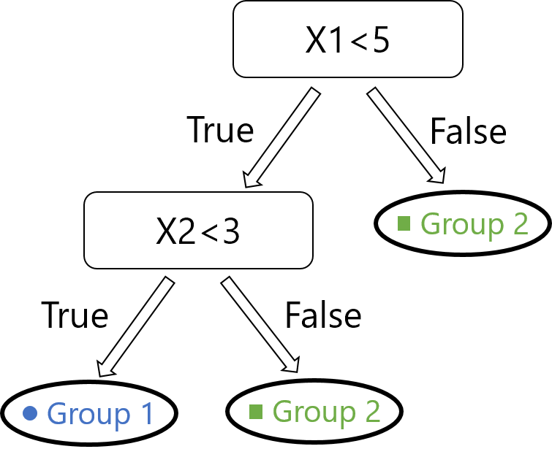
Recursive Partitioning and Impurity
Notes:
Guidelines
Use a title slide at the beginning of your presentation. There are 9 variations of title slides to choose from.
If you will have a series of slideshows, we recommend using the same style of title slide for each presentation.
Keep your title to no more than 2 lines.
Do not change the font style or font size of the title or subtitle.

Slide 3
Trees are Rules-Based Algorithms
Goal: Classify or predict an outcome based on a set of predictors
Example of Rule for Tree Below:
1) IF (X1 < 5) AND (X2 < 3) THEN Class = “Group 1”
2) IF (X1 < 5) AND (X2 >= 3) THEN Class = “Group 2”
3) IF (X1 >= 5) THEN Class = “Group 2”

Slide 4
Decision Trees
Also called CART, Decision Trees, or just Trees
Rules are represented by tree diagrams, but internally coded as rules (IF … THEN … ELSE)
Predictions are the most common class in the node

Slide 5
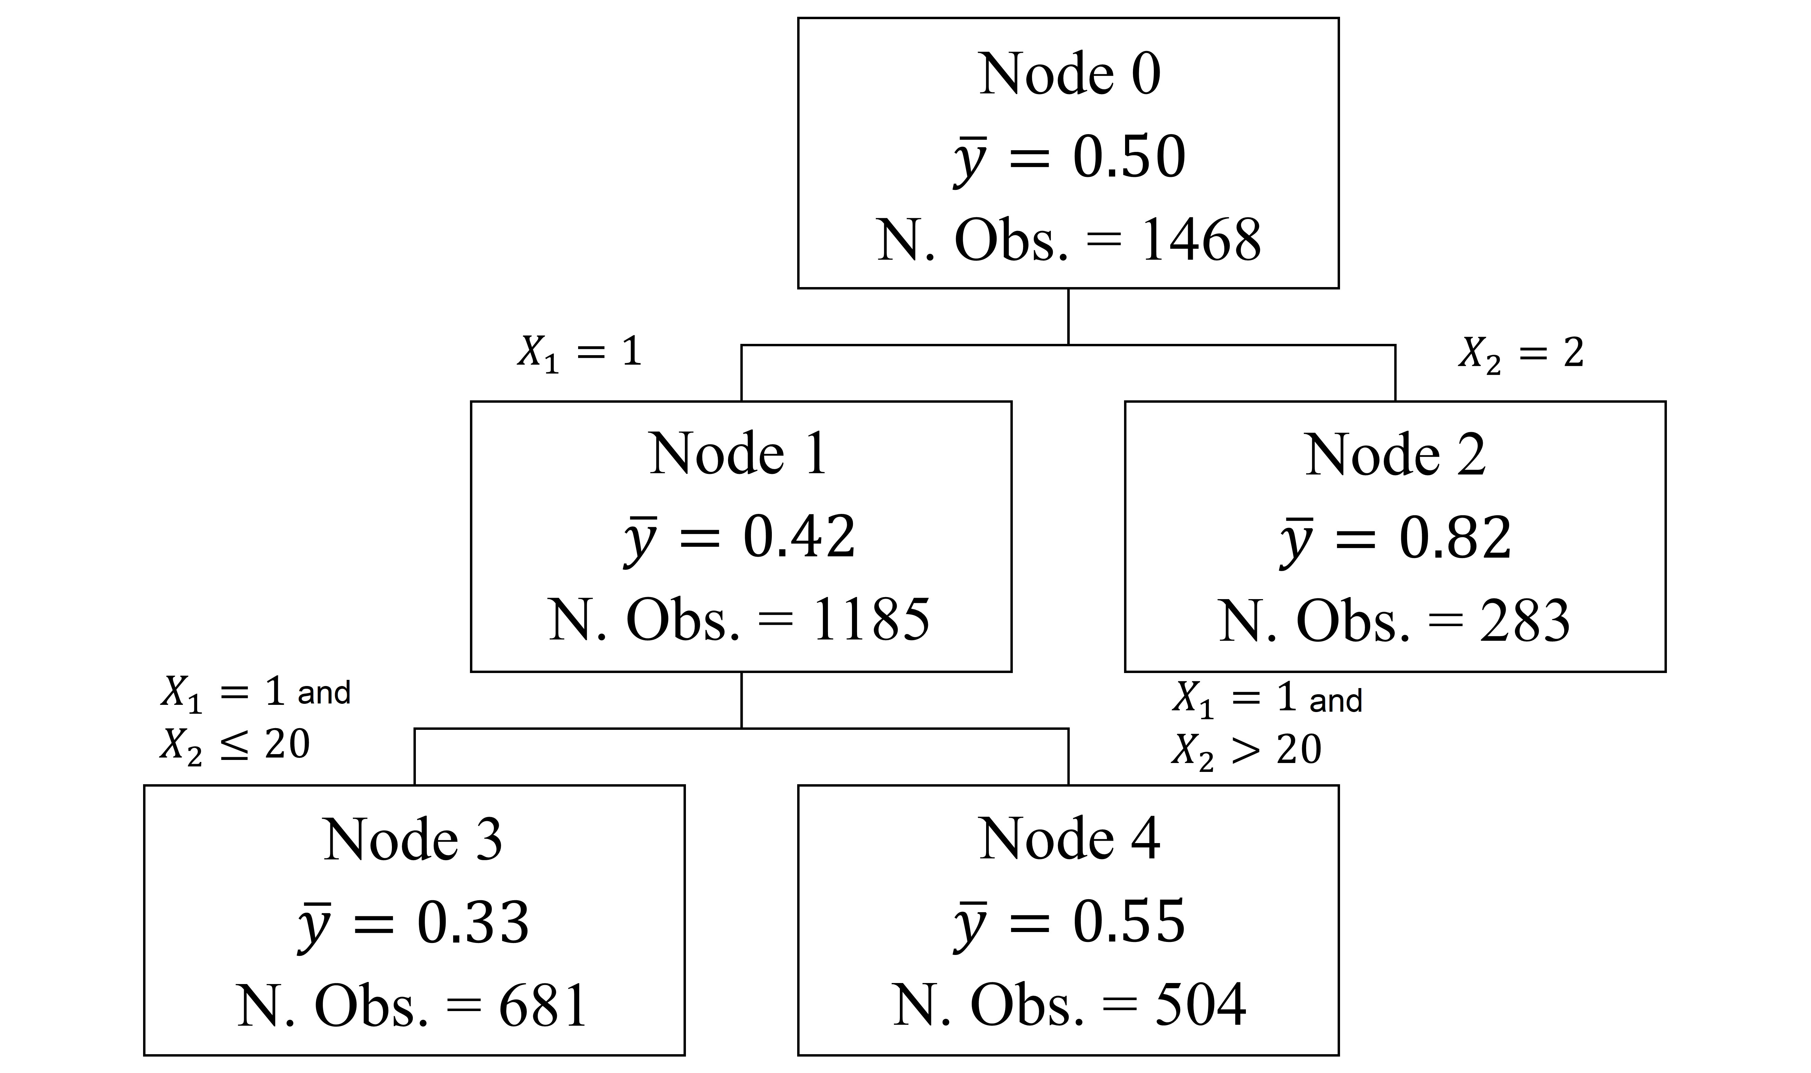
Regression Trees
Also called decision tree regressors
Also use rules
Rules are represented by tree diagrams
Predictions are the averages of the node
1) IF (X1 = 1) AND X2 <= 20 THEN prediction = 0.33
2) IF (X2 = 1) AND (X2 > 20) THEN prediction = 0.55
3) IF (X2 = 2) THEN prediction = 0.82

Slide 6
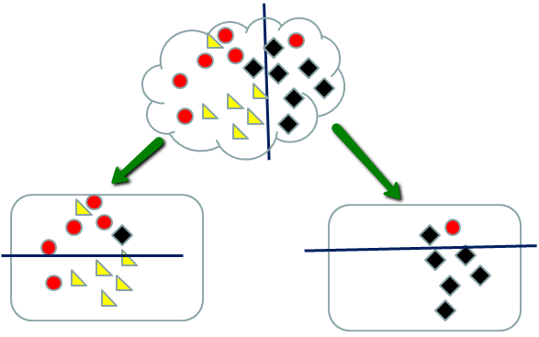
Recursive Partitioning
Repeatedly split the nodes into two parts to decrease impurity
Stop when no more impurity or stopping rule triggered

Slide 7
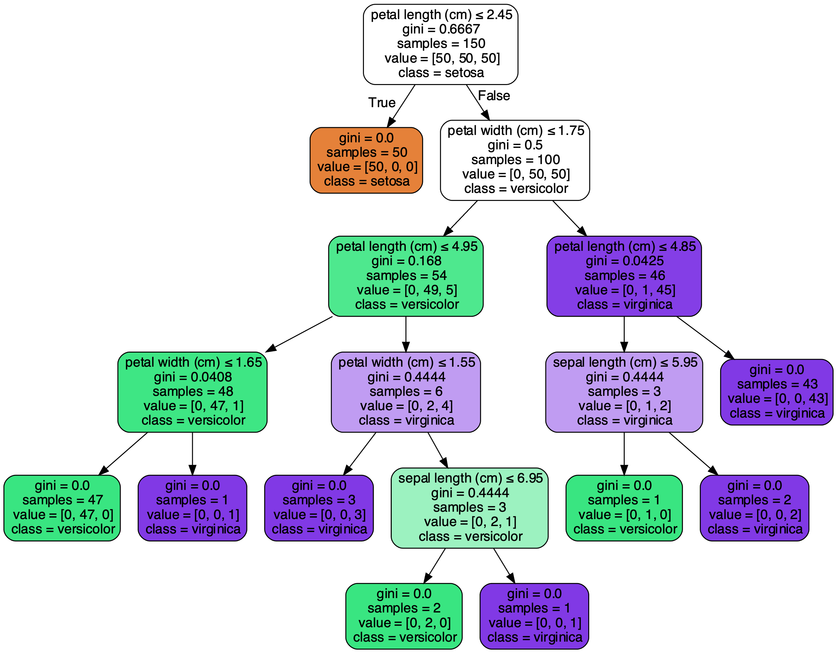
Recursive Partitioning

Slide 8
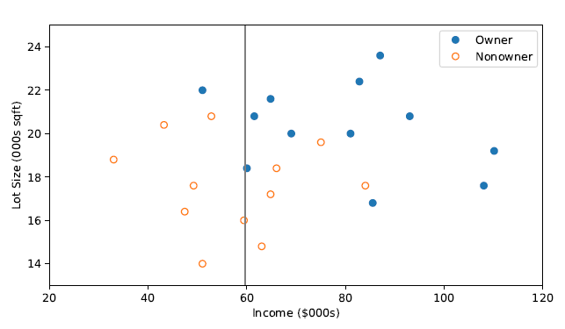
How to Measure Impurity
There are some metrics we can use
Gini Index (Classification)
Entropy (Classification)
RMSE (Regression)
These metrics are computed at each node for ALL possible splits

Slide 9
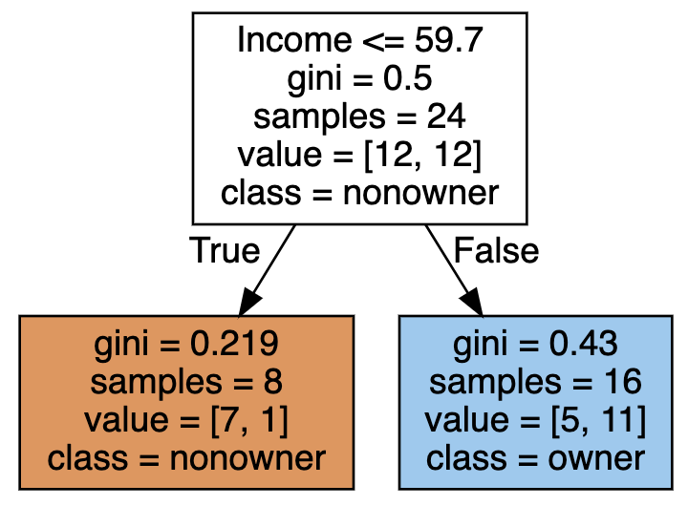
How to Measure Impurity
There are some metrics we can use
Gini Index (Classification)
Entropy (Classification)
RMSE (Regression)
These metrics are computed at each node for ALL possible splits

Slide 10
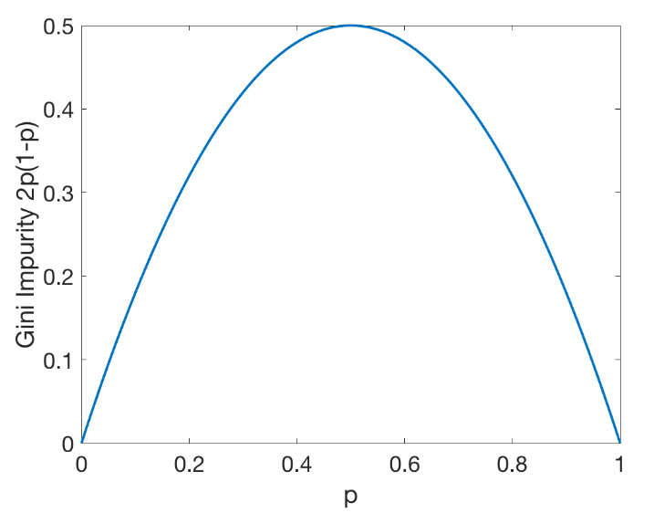

The Gini Index (Classification)
There Gini Index is calculated as: $1−∑p_{k}^{2}$
The $p_{k}$ are the proportions of each class of the the target variable
For the binary case the formula can be simplified to $2p_{1}p_{2}$ and maximum is 0.5

Slide 11

The Gini Index (Root Node)
Calculation of Gini Index at Root Node
$2∗\frac{12}{24}∗\frac{12}{24}=0.5$

Slide 12

The Gini Index (Right Node)
Calculation of Gini Index at Right Node
$2∗\frac{5}{16}∗\frac{11}{16}=0.4296875$

Slide 13

The Gini Index (Left Node)
Calculation of Gini Index at Left Node
$2∗\frac{7}{8}∗\frac{1}{8}=0.21875$

Slide 14

The Gini Index (Combined Split)
What was the combined impurity decrease?
The Gini of the combined split is $\left(\frac{8}{24}∗0.219+\frac{16}{24}∗0.43\right)=\text{0.359}$
The Decrease from the split is $0.5 − 0.359=0.141$

Slide 15
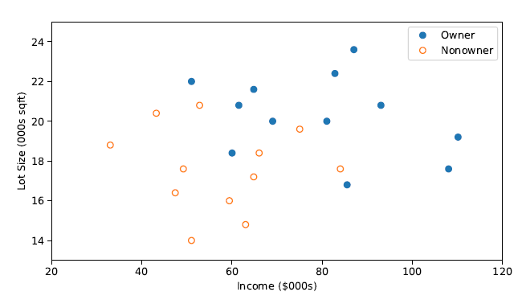
The Gini Index
These Gini Index is computed at each node for ALL possible splits

Slide 16
The Gini Index
These Gini Index is computed at each node for ALL possible splits

Slide 17
The Gini Index
These Gini Index is computed at each node for ALL possible splits

Slide 18
The Gini Index
These Gini Index is computed at each node for ALL possible splits

Slide 19
The Gini Index
These Gini Index is computed at each node for ALL possible splits

Slide 20
The Gini Index
These Gini Index is computed at each node for ALL possible splits

Slide 21
The Gini Index
These Gini Index is computed at each node for ALL possible splits

Slide 22
The Gini Index
These Gini Index is computed at each node for ALL possible splits

Slide 23
The Gini Index
These Gini Index is computed at each node for ALL possible splits

Slide 24
The Gini Index
These Gini Index is computed at each node for ALL possible splits

Slide 25
The Gini Index
These Gini Index is computed at each node for ALL possible splits

Slide 26
The Gini Index
These Gini Index is computed at each node for ALL possible splits

Slide 27
The Gini Index
These Gini Index is computed at each node for ALL possible splits

Slide 28
The Gini Index
These Gini Index is computed at each node for ALL possible splits

Slide 29
The Gini Index
These Gini Index is computed at each node for ALL possible splits

Slide 30
The Gini Index
These Gini Index is computed at each node for ALL possible splits

Slide 31
The Gini Index
These Gini Index is computed at each node for ALL possible splits

Slide 32
The Gini Index
These Gini Index is computed at each node for ALL possible splits
$$Gini Index Improvement 0.141$$

Slide 33
Python
Notes:
Guidelines
Use a title slide at the beginning of your presentation. There are 9 variations of title slides to choose from.
If you will have a series of slideshows, we recommend using the same style of title slide for each presentation.
Keep your title to no more than 2 lines.
Do not change the font style or font size of the title or subtitle.

Slide 34
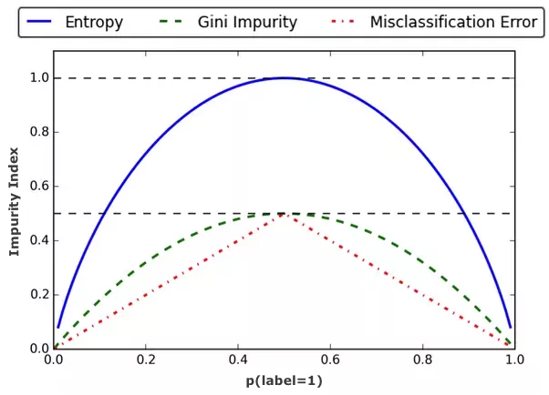
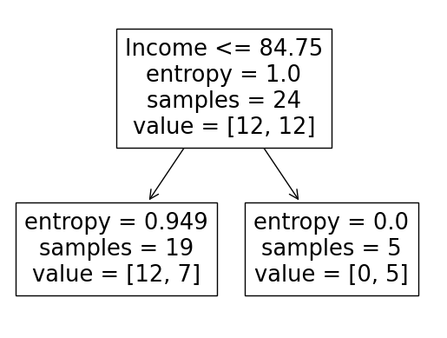

The Entropy (Classification)
calculated as: $−∑p_{k}\log_{2}{p_{k}}$
The $p_{k}$ are the proportions of each class of the the target variable
Also called binary cross-entropy and information gain

Slide 35
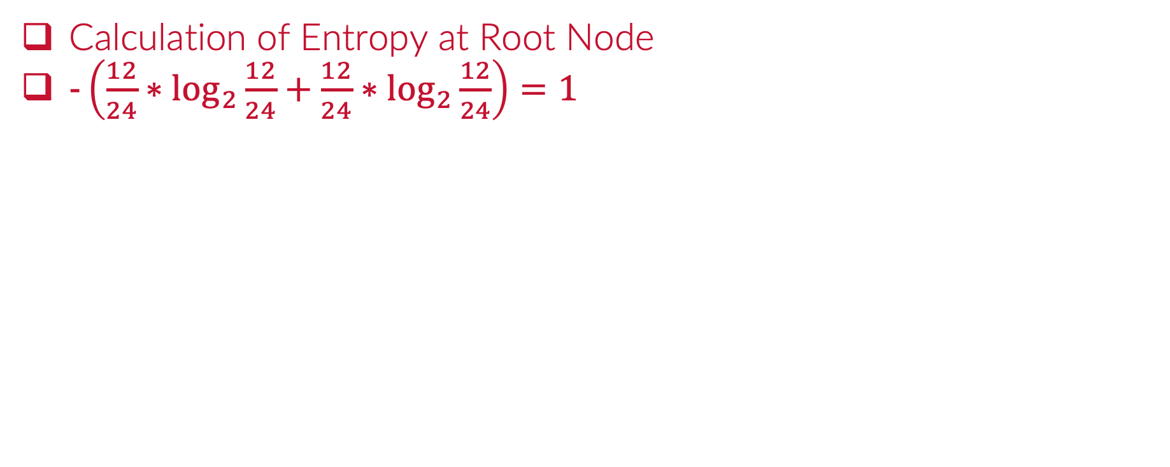
The Entropy (Root Node)
Calculation of Entropy at Root Node
$−\left(\frac{12}{24}∗\log_{2}{\frac{12}{24}}+\frac{12}{24}∗\log_{2}{\frac{12}{24}}\right)=1$

Slide 36

The Entropy (at Right Node)
Calculation of Entropy at Root Node
$−\left(\frac{0}{5}∗\log_{2}{\frac{0}{5}}+\frac{5}{5}∗\log_{2}{\frac{5}{5}}\right)=0$

Slide 37

The Entropy (at Left Node)
Calculation of Entropy at Root Node
$−\left(\frac{12}{19}∗\log_{2}{\frac{12}{19}}+\frac{7}{19}∗\log_{2}{\frac{7}{19}}\right)=\text{0.949452}$

Slide 38

The Entropy (Combined Split)
$\text{What} \text{was} \text{the} \text{combined} \text{impurity} \text{decrease}\text{?}$
$\text{The} \text{Gini} \text{of} \text{the} \text{combined} \text{split} \text{is} \left(\frac{19}{24}∗\text{0.949}+\frac{5}{24}∗0\right)\text{=}\text{0.75}\text{2 }$
$\text{The} \text{Decrease} \text{from} \text{the} \text{split} \text{is} 1 − 0.752=\text{0.248}$

Slide 39
The Entropy
The Entropy is computed at each node for ALL possible splits
$$Entropy Improvement 0.248$$

Slide 40
Python
Notes:
Guidelines
Use a title slide at the beginning of your presentation. There are 9 variations of title slides to choose from.
If you will have a series of slideshows, we recommend using the same style of title slide for each presentation.
Keep your title to no more than 2 lines.
Do not change the font style or font size of the title or subtitle.

Slide 41

Regression Trees
The impurity metrics can be:
Squared error (MSE) $\frac{1}{n}∑{\left(y −\overline{y}\right)}^{2}$
Friedman MSE
Absolute error (MAE) $\frac{1}{n}∑\left|y −\overline{y}\right|$
1) IF (X1 = 1) AND X2 <= 20 THEN prediction = 0.33
2) IF (X2 = 1) AND (X2 > 20) THEN prediction = 0.55
3) IF (X2 = 2) THEN prediction = 0.82

Slide 42
Python
Notes:
Guidelines
Use a title slide at the beginning of your presentation. There are 9 variations of title slides to choose from.
If you will have a series of slideshows, we recommend using the same style of title slide for each presentation.
Keep your title to no more than 2 lines.
Do not change the font style or font size of the title or subtitle.

